Slide 1
Reading Meeting
Reception

Slide 2
Speaking and Listening
Speaking and listening are vital skills children need to develop in order to live successful lives in society.
They are key skills for children developing their ability to read and write.

Slide 3
How to Help Develop Speaking and Listening Skills
Talk to them.
Ask questions.
Model and expect good listening.
Encourage the understanding and use of new vocabulary.
Sing songs, rhymes and read poems, enjoying the rhyme and rhythm of words.
Read to your child regularly and develop their story language.

Slide 4
Phonics
We use Little Wandle Letters and Sounds revised to teach reading.
Letters and Sounds is a systematic approach for teaching children to read using phonics. It is used in many schools in England. It is split into six phases, from starting to learn about sounds at nursery to becoming fluent readers around age 7.

Slide 5
Phase 1
All about sounds, musical, environmental, voice and body
Aural discrimination of sounds, including letter sounds
Blending and segmenting orally

Slide 6
Phase 2
Learning specific letters and sounds
Reading sight words: I, go, no, to, the
Blending and segmenting vc and cvc
words, and in captions and sentences

Slide 7
Pronunciation of Sounds
Here is a video showing the pronunciation of the first sounds your child will learn. When learning to read it is particularly important children use the correct pronunciation of sounds as it makes blending easier. https://www.littlewandlelettersandsounds.org.uk/resources/for-parents/

Slide 8
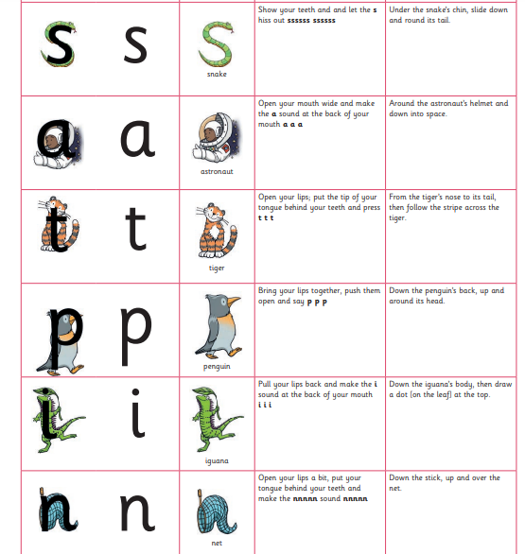
Pronunciation of Sounds

Slide 9
Phase 3
All other sounds are taught, but only one representation
Alphabet names are important to describe the sounds made by more than one letter
More tricky words for reading
Writing tricky words - I go no to the
Blending, segmenting, reading, writing words, captions and sentences

Slide 10
Phase 4
Adjacent consonants introduced
cvcc words – ten-t mil-k jum-p
ccvc words – d-rum p-lop s-poon
ccvcc words – th-a-nk

Slide 11
Phonics Vocabulary
Phonics – the learning of letters and sounds
Phoneme – the sound a letter makes
Grapheme – the written letter
Blending – running sounds together to make a word
Segmenting – breaking a word up into its component sounds
Sight words – words that cannot be decoded using phonics
cvc – c = consonant (b/c/d/f), v = vowel (a/e/ee)
Digraph - a sound made with two letters eg. sh ai oi
Phonetically plausible – written phonetically

Slide 12
Reading at Home
Your child will take home two sorts of books:
Sharing books: The sharing book is a book your child has chosen for you to enjoy together. Read it to them or with them – enjoy the story and have fun!
Reading practice book: This book will correspond with your child’s progress in reading. Listen to your child read the book and remember to use lots of praise! If they can’t read a word, read it to them and move on quickly.
Please initial your child’s reading record to show that you’ve spent time reading together, either with their sharing book, or their reading practice book.

Slide 13
How is Reading Taught in School?
Daily Phonics sessions
- Learning to recognise letters and the sounds they make
- Learning to blend sounds into words e.g. c-a-t
- Learning tricky words (words that cannot be decoded e.g. the) as a sight vocabulary
Sharing books – for you to read to your child and discuss
Reading books – regular reading at school and at home

Slide 14
How Can I Support Reading at Home?
Ask your child to read their reading book to you. They should be retelling you the story in their own words as this helps them to build up their vocabulary.
Make sure your child sees you reading.
Read to your child. Show you like the book. Bring stories to life by using loud, soft, scary voices – let yourself go!
Leave books around the house for your child to dip into.
Let your child choose what they would like to read – books, comics, catalogues.
Read favourite books over and over again. Enjoy!
Ask your child to read you their favourite story using the pictures as prompts.
Visit the library and choose books to read together at home.

Slide 15
Writing at School
Daily phonics session
-Learning to recognise graphemes
-Segmenting for writing (knowing a word such as dog is made up of three sounds d-o-g)
-Tricky words
Letter formation
Mark making opportunities
Physical development for writing (building muscle strength)
Busy Fingers
Encouraging independence

Slide 16
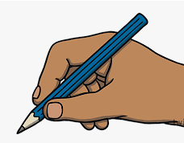
How Can I Support Writing at Home?
Reinforce correct letter formation – see Little Wandle Handout for Handwriting Ditties
Encourage drawing, writing and mark making
Encourage tripod pencil grip
Model everyday writing – shopping lists, letters, cards, notes ect
Do not spell everything out for them – encourage them to sound it out.
Encourage independence

