Slide 1
Welcome to Early Years
Offley Endowed Primary School and Nursery

Slide 2
Welcome Meeting
Welcome from the head
Messages from the administrative team
Transition talk from class teachers

Slide 3
Aims
To inform you of our transition processes.
To give you an overview of what your child will be learning and experiencing in our Early Years.
To help you understand what to expect from us.
To provide ideas on how we can effectively work together and how you can best support your child at home.

Slide 4
Transition: A process not an event
We will work with you to help your child to settle and be confident in their new surroundings
Our transition processes are based on the best interests and needs of your child
Each child is different and some may take a little longer to settle

Slide 5
Office Admin
Office opening times from 8am – 4pm (Claire/Mel)
School Start / End Times : 8.45-3.10 (Rec) or 9.00-3.00 (Nursery)
Absences – please email or call the school by 9.00am (stating reason – not just ‘ill’).
Other
Please inform the office of any allergies or changes in medical conditions/change of email/phone/home address.
Please try to avoid non-urgent medical appts in school hours (e.g. dentist). Hospital & Medical appts – proof please.
If you need us to administer medicine, the medicine must be handed in and collected from office – the child cannot carry medicine in their bags. Forms to be filled out in the office
Gateway app / School Comms /Parent Pay – sign up for – all messages, booking clubs (Jesters/BC), consents for trips, payments etc. are through this app.

Slide 6
School Dinners
Dinners are through Dolce Catering, ordering is through School Grid https://app.schoolgrid.co.uk/
Your child is already set up, please see the office if you cannot order. All children can order a dinner, 3 weekly menu rotation. Pick and choose– mix and match with packed lunch; (menu on website).
Please cancel their dinners if your child is absent.
Cut off times are; 8.55am for the parent; 9.45am for the office. No pre orders will probably get a jacket (not fair on the kitchen staff).
We would recommend to order for at least a week in advance, if not the term.
£2.82 – Nursery
FOC Rec – year 2. (please register)
(KS2 is £3.20)

Slide 7
Nursery sessions – if not full time - £18.00 per session (half day) 9-12 or 12-3 (subject to availability)
We ask you to keep your sessions for a term, we can accommodate small changes and additional days as a one off.
Breakfast club
Open from 7.45am daily (cut off midnight before) £4 or £5 (sibling discount available) Preferably be in before 8.15 if eating breakfast.
Jesters (after school club)
Mon-Thursday - 3.00 or 3.10 until 5.45 -one hour / two hours or 2.5 hours (cut off 3pm on the day) calculates at £5 per hour includes a snack. Fridays only 1 hour.
Milk – sign up via Coolmilk.com – free until the week before their 5th birthday (thereafter currently 36p/day).
Water bottles are supplied by the school when they join. Year 2 onwards, need buy one.

Slide 8
Collections
Any changes to collections – must inform the office (try to avoid busy times) 8.30-9.30 and 2.30-3.30pm. If regular - can add persons ‘authorised to collect’ so you do not have to keep calling.
Always collect child from the office if late/medical/illness - must sign out for fire regs
FSM – whilst free (for Reception) – may be eligible for extra funding, please see the office in confidence if you think you maybe eligible (or collect letter)
Pre-loved uniform and wellies, if needed/ financial difficulty – please see office (confidential).
Every thing available on our website (under)
Parents»
New Intake Information»
Registration information - Reference Documents

Slide 9
Getting to Know You and Your Child
Parents welcome meeting
Stay and play sessions in new environment
Opportunity to try a school lunch
Information gathered from previous setting
Opportunities to ask questions and share concerns during this meeting and stay and play sessions.
All about me forms and transition forms
Notes:
Edit this slide to reflect your own support for transition.
Talk about all the different ways you get to know the child and their family and the opportunities to share and exchange information about their child.
Explain how the key person relationship supports children to settle well.
Emphasise that staff are available to talk to parents who have concerns about their child.

Slide 10
What is the EYFS?
EYFS stands for the Early Years Foundation Stage.
All settings working with 0-5 year olds follow the EYFS statutory framework.
It has four over arching principles: a unique child, positive relationships, enabling environments and learning and development.
There are 7 areas of learning which are provided through a variety purposeful play, guided learning and direct teaching activities.
All areas of learning are reflected in the classroom and in the outdoor areas. The learning environment and resources are constantly changing depending on children’s interests, their next steps in learning and the curriculum and topic.

Slide 11
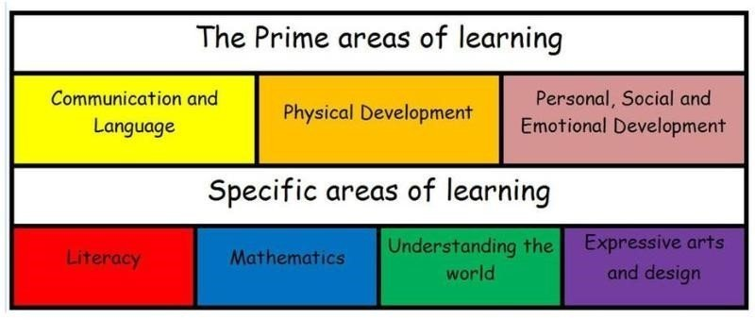

Slide 12
Communication and Language
Speaking
Listening
A rich language environment
Express themselves and their ideas

Slide 13
Personal, Social and Emotional Development
Building confidence and independence
Making friends
Learning rules
Learning daily routines
Learning about others
Understanding and celebrating differences
Understanding boundaries
Managing feelings
Developing positive relationships

Slide 14
Physical Development
Gross and fine motor skills
Busy fingers and malleable area
Mark making area
Shoes and coats
PE lessons and getting changed too (in Reception)
Making healthy choices

Slide 15
Literacy
Reading – at school and home, including library books and levelled books.
Phonics
Drawing and mark making
Writing

Slide 16
Mathematics
Counting
Number recognition, value and composition
Calculation
Shape
Pattern
Practical problem solving
Measuring

Slide 17
Understanding the World
Exploring and investigating
Learning about their local community and different cultures, religions and places
Use their senses to explore the world around them and different life processes
Begin to compare the past to the present

Slide 18
Expressive Arts and Design
Story
Role play
Imagination
Art
Painting
Drawing
Dance
Music
Singing

Slide 19
A Typical Day in Nursery
9.00am - Busy fingers and registration
9.15am-9.30am - phonics
9.30am–11.10am – snack and play and learn
11.10am-12 noon – adult lead learning activities
12 noon-1.15pm - lunch time and play
1.15pm–1.30pm – worship time
1.30pm–2.00pm – adult led learning activities
2.00pm-2.45pm – play and learn
2.45pm-3.00pm - story time, singing and handover

Slide 20
A Typical Day in Reception
8.45am - busy fingers and registration
9.00am- 10.00am - phonics, adult led learning activities
10.00am-10.15am – snack time
10.15am-11.00am – play and learn
11.00am-11.20am – assembly/collective worship
11.20am-12.10pm – maths, adult led learning activities, story time
12.10pm-1.15pm - lunch time and play
1.15pm-2.00pm - adult led learning activities
2.00pm–2.45pm – play and learn
2.45pm-3.10pm - story time, singing and handover

Slide 21
We love outdoor learning!
Named wellies if possible though we do have some spare.
Suitable coat for our changeable weather.
Mess!

Slide 22
Buddies
Reception children will be assigned a year 6 buddy.
The aim of the buddies is to ensure that all children can enjoy their break and lunch times knowing that there will always be people on hand to play with.
Buddies come and work with Reception children throughout the course of the year.
Notes:
NOTE: To change images on this slide, select a picture and delete it. Then click the Insert Picture icon in the placeholder to insert your own image.

Slide 23
Learning Journeys
A Learning Journey is a collection of evidence celebrating a child's progression and development through the EYFS. Throughout their time in Nursery and Reception observations, photos and work samples are collated by practitioners and documented into their book.
Contribute to your child’s Learning Journey by sending in photos and comments about learning at home on dojo or on paper.
Parents/carers will be given opportunities to view their child’s learning journey at parent’s evenings and you will then receive it at the end of Nursery and Reception.

Slide 24
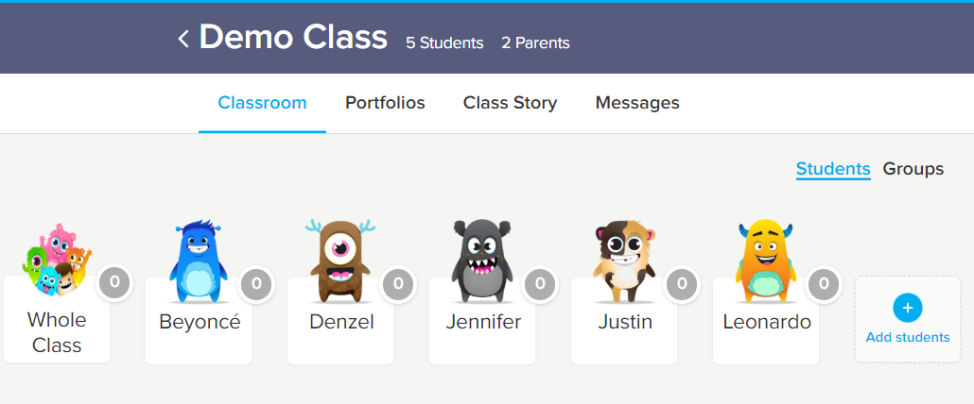
Dojo
Curriculum plans, activities in class, messages home, reminders, photos of what we have been doing in class.
You can send messages to us directly through dojo if they are not urgent. You can also chat to us in the morning on the playground or make an appointment via the office.
Dojo points are given for a variety of reasons including being helpful or working hard. If they are ‘over the rainbow’ they have done well and if they are ‘out of this world’ they have done very, very well!

Slide 25
Things to do Before September
Fill out all paper work in your pack and return to the school Office.
Pre order any school dinners using Live Kitchen app (see information pack for further instructions)
Sign up to Cool Milk and order any milk for your child (see information pack for further instructions)
Please sign up to class Dojo once you have received your invitation email. Please keep an eye on your junk folder.
Please make sure your child has a school book bag or similar bag (ideally same shape). If everything can fit in great, if not, they can bring in a small back pack.

Slide 26
Things to do Before September
Order any uniform you might like (uniform with the school logo on is optional). Uniform with a school logo is available from Beats school uniform.
Nursery children are encouraged to wear school uniform tops and their own leggings/shorts/trousers/skirt. They are welcome to wear all uniform if they wish to!
Pre-loved uniform will be available at the summer fair, on Thursday 17th July, for a small contribution.
PE kit to be ready to bring in and stay in school (Reception children only).
Please ensure all clothing is named!
Your child will be provided with a school water bottle.
If your child requires any medicines please ensure they are ready to bring into school on the first day.
Encourage your child to be as independent as possible – dressing themselves and feeding themselves.

Slide 27
On the First Day of School
The first day of school will be Thursday 4th September; school starts at 8.45am for Reception and 9.00am for Nursery. The teacher will come to the playground to collect them from you.
For the first week you may want to come into the classroom with your child and settle them to an activity.
School will finish at 3.00pm for Nursery (or 12 noon if they are attending for mornings only) and 3.10pm for Reception. Nursery children will be handed over just outside the school office (please wait just in front of the office). Reception children will come through the large black gate at the back of the playground with their teacher.
Half days are optional for the first week of school when you can collect your child at 1.20pm (after lunch).
If your child is being collected by a different adult at anytime you must inform the school office.

Slide 28

Your Child
Tell us what your child enjoys doing by writing it on a post-it (make sure you include their name and hand to a member of staff)
Think about what you want for your child when they start school and write it on a post-it (make sure you include their name and hand to a member of staff)

Slide 29
Thank you for coming!
Please do not hesitate to ask us any questions big or small!
If you feel you need to discuss any particular concerns about your child and their transition please make an appointment with the office.

