Slide 1

Welcome to Reception & Nursery

Slide 2
Agenda
Welcome from the head
Messages from the administrative team
Transition talk from class teachers
To inform you of our transition processes.
To give you an overview of what your child will be learning and experiencing in our Early Years.
To provide ideas on how we can effectively work together and how you can best support your child at home.
Aims

Slide 3

Transition: A Process Not an Event
We will work with you to help your child to settle and be confident in their new surroundings.
Our transition processes are based on the best interests and needs of your child.
Each child is different and some may need extra support and take a little longer to settle.

Slide 4
Office – General Information
Office opening times from 8am – 4pm (Claire/Mel)
School Start / End Times : 8.45-3.10 (Rec) or 9.00-3.00 (Nursery)
Absences – please email or call the school by 9.00am (if your child has sickness or diarrhea they must stay off school for at 48 hours.)
Please inform the office of any allergies or changes in medical conditions/change of email/phone/home address.
Please try to avoid non-urgent medical appts in school hours (e.g. dentist). Hospital & Medical appts – proof please.
If you need us to administer medicine, the medicine must be handed in and collected from office – the child cannot carry medicine in their bags. Forms to be filled out in the office
Gateway app / School Comms /Parent Pay – sign up for – all messages, booking clubs (Jesters/BC), consents for trips, payments etc. are through this app.

Slide 5
Office – School Dinners
Dinners are through Dolce Catering, ordering is through School Grid
https://app.schoolgrid.co.uk/
Your child is already set up, please see the office if you cannot order. All children can order a dinner, 3 weekly menu rotation. Pick and choose– mix and match with packed lunch; (menu on website).
Please cancel their dinners if your child is absent.
Cut off times are; 8.55am for the parent; 9.45am for the office. No pre orders will probably get a jacket potato.
We would recommend to order for at least a week in advance, if not the term.
£2.82 – Nursery
Free of Charge - Reception – year 2 (please register)
(KS2 is £2.95)

Slide 6
Office – Wrap Around Care
Nursery sessions –£ 6.50 an hour - sessions 9-12, 12-3, full time
(subject to availability)
We ask you to keep your sessions for a term, we can accommodate small changes and
additional days as a one off.
Breakfast club - Open from 7.45am daily (cut off midnight before) £4 or £5 (sibling discount available) Preferably be in before 8.15 if eating breakfast.
Jesters (after school club) - Mon-Thursday - 3.00 or 3.10 until 5.45 -one hour / two hours or 2.5 hours (cut off 3pm on the day) calculates at £5 per hour includes a snack. Fridays only 1 hour.

Slide 7
Office – Frequently Asked Questions
Any changes to collections – must inform the office (try to avoid busy times)
8.30-9.30 and 2.30-3.30pm. If regular - can add persons ‘authorised to collect’.
Always collect child from the office if late/medical/illness - must sign out for fire regs
Free School Meals – whilst free (for Reception) – may be eligible for extra funding, please see the office in confidence if you think you maybe eligible (or collect letter)
Pre-loved uniform and wellies, if needed/ financial difficulty – please see office (confidential).
Water bottles are supplied by the school when they join. Year 2 onwards, need buy one.
Milk – sign up via Coolmilk.com – free until the week before their 5th birthday (thereafter currently 31p/day).

Slide 8
Getting to Know You and Your Child
Parents welcome meeting
Stay and play sessions in new environment
Opportunity to try a school lunch
Information gathered from previous setting
Opportunities to ask questions and share concerns during this meeting and stay and play sessions.
All about me forms and transition forms

Slide 9
What is EYFS?
EYFS stands for the Early Years Foundation Stage.
All settings working with 0-5 year olds follow the EYFS statutory framework.
It has four over arching principles: a unique child, positive relationships, enabling environments and learning and development.
There are 7 areas of learning which are provided through a variety purposeful play, guided learning and direct teaching activities.
All areas of learning are reflected in the classroom and in the outdoor areas. The learning environment and resources are constantly changing depending on children’s interests, their next steps in learning and the curriculum and topic.

Slide 10
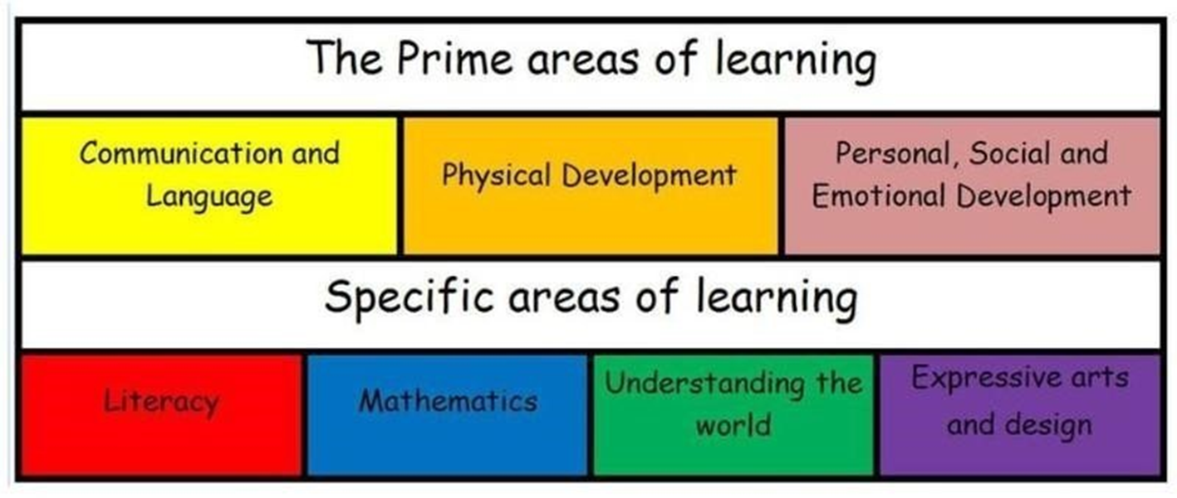
What is EYFS?

Slide 11
Communication and Language
Speaking
Listening
A rich language environment
Express themselves and their ideas

Slide 12
Personal, Social and Emotional Development
Building confidence and independence
Making friends
Learning rules
Learning daily routines
Learning about others
Understanding and celebrating differences
Understanding boundaries
Managing feelings
Developing positive relationships

Slide 13
Physical Development
Gross and fine motor skills
Busy fingers and malleable area
Mark making area
Shoes and coats
PE lessons and getting changed too (in Reception)
Making healthy choices

Slide 14
Literacy
Reading – at school and home, including library books and levelled books.
Phonics
Drawing and mark making
Writing

Slide 15
Mathematics
Counting
Number recognition, value and composition
Calculation
Shape
Pattern
Practical problem solving
Measuring

Slide 16
Understanding the World
Exploring and investigating
Learning about their local community and different cultures, religions and places
Use their senses to explore the world around them and different life processes
Begin to compare the past to the present

Slide 17
Expressive Art and Design
Story
Role play
Imagination
Art
Painting
Drawing
Dance
Music
Singing

Slide 18


Slide 19
Lunchtimes
All children sit together at lunchtimes. There is a mix of packed lunch and
school dinners.
We support all children with getting their lunch and settling.
After lunch Nursery play in Early Years garden and Reception use the main playground.
If your child has a packed lunch please provide a drink.
We are a nut free school (due to allergies).
We don’t allow fizzy drinks, chocolate bars and sweets as part of packed lunches.

Slide 20


Slide 21
On the First Day of School
The first day of school will be Wednesday 2nd September; school starts at
8.45am for Reception and 9.00am for Nursery. The teacher will come to the
playground to collect them from you (far end of the playground).
For the first week you may want to come into the classroom with your child and settle them to an activity.
School will finish at 3.00pm for Nursery (or 12 noon if they are attending for mornings only) and 3.10pm for Reception. Nursery children will be handed over just outside the school office (please wait just in front of the office). Reception children will come through the large black gate at the back of the playground with their teacher.
Half days are optional for the first week of school when you can collect your child at 1.20pm (after lunch).
If your child is being collected by a different adult at anytime you must inform the school office.

Slide 22
We Love Outdoor Learning
Named wellies if possible though we do have some spare.
Suitable coat for our changeable weather.
Mess!

Slide 23
Buddies
Reception children will be assigned a year 6 buddy.
The aim of the buddies is to ensure that all children can enjoy their break and lunch times knowing that there will always be people on hand to play with.
Buddies come and work with Reception children throughout the course of the year.

Slide 24
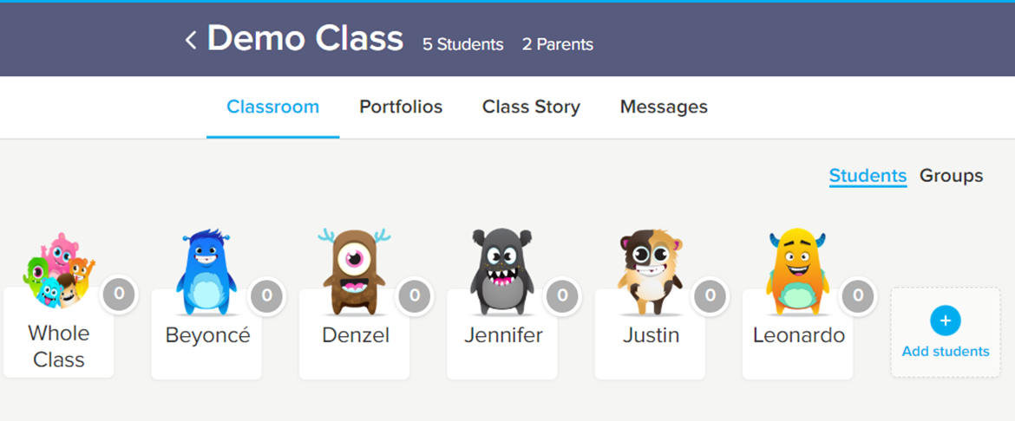
Dojos
Curriculum plans, activities in class, messages home, reminders, photos
of what we have been doing in class.
You can send messages to us directly through dojo if they are not urgent. You can also chat to us in the morning on the playground or make an appointment via the office.
Dojo points are given for a variety of reasons including being helpful or working hard. If they are ‘over the rainbow’ they have done well and if they are ‘out of this world’ they have done very, very well!

Slide 25
Your Child
Tell us what your child enjoys doing by writing it on
a post-it (make sure you include their name and hand
to a member of staff)
Think about what you want for your child when they start school and write it on a post-it (make sure you include their name and hand to a member of staff)

Slide 26
Thank You
Please do not hesitate to ask us any questions big or small!
If you feel you need to discuss any particular concerns about your child and their transition please make an appointment with the office.

